Slide 1
CUBAS Training
CUBAS COM Stack Overview
Notes:
Niranjan S K

Slide 2

CUBAS : COM Stack Overview
Agenda
  COM Stack Architecture (from various releases of Autosar)
  Autosar COM stack in BOSCH and CUBAS
  Communication Services - Introduction
  Communication Services on CAN
  Communication Services on LIN
  Communication Services on FlexRay
  PDU Nomenclature in Autosar
  DCM
  COM
  NM
Notes:
Niranjan S K

Slide 3
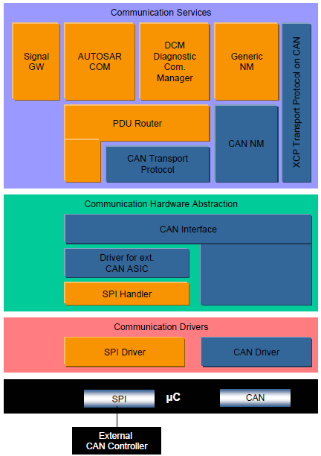
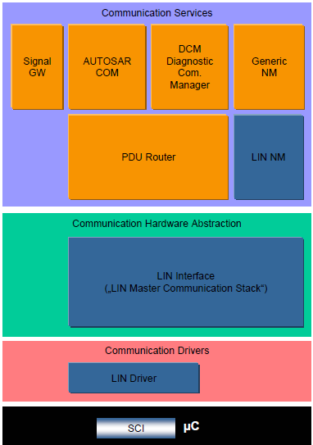
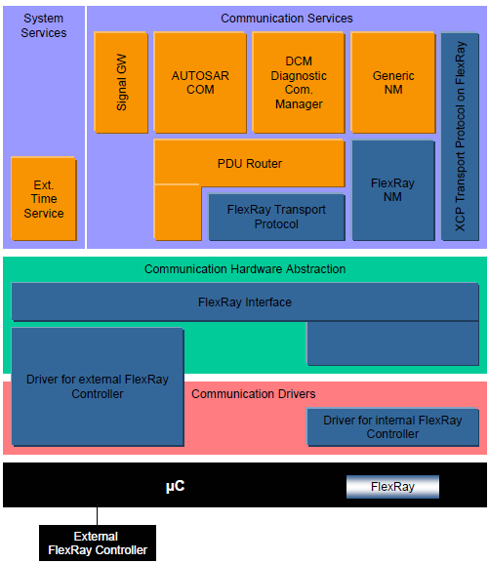
COM Stack Architecture (Autosar 1.0)
Notes:
Niranjan S K

Slide 4
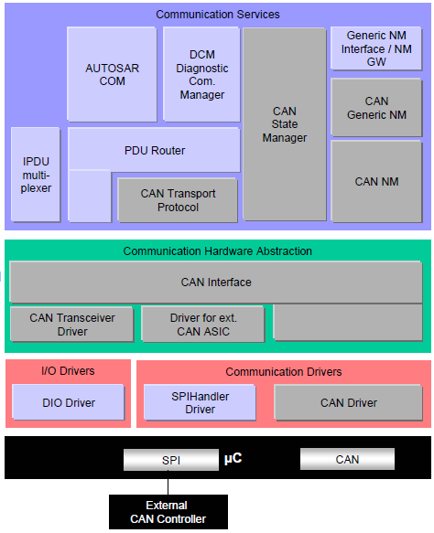
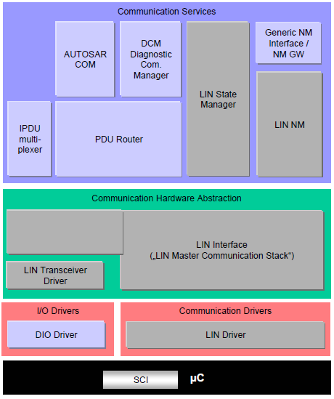
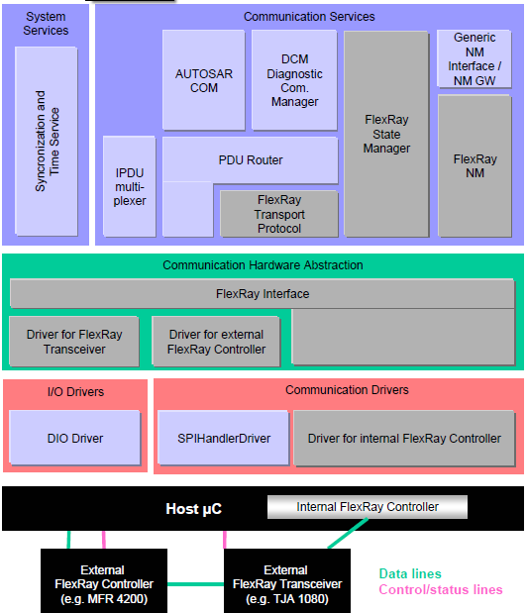
COM Stack Architecture (Autosar 2.1)
Notes:
Niranjan S K

Slide 5
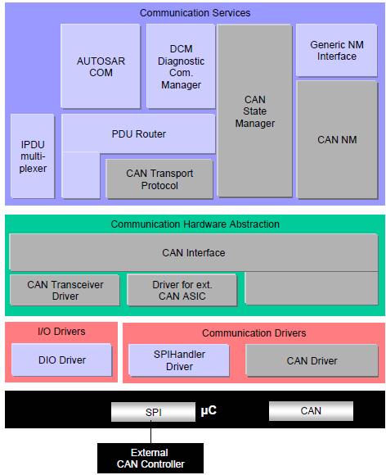
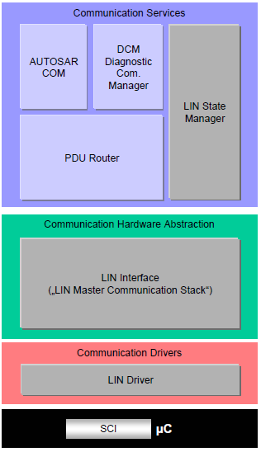
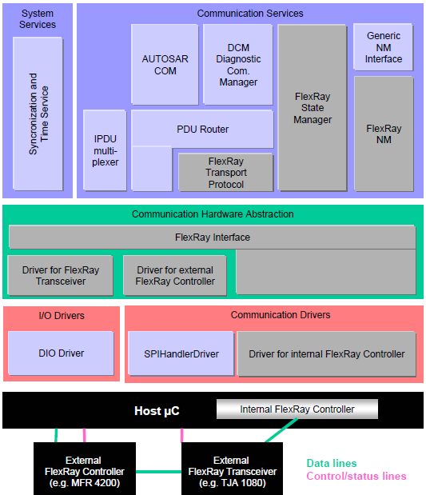
COM Stack Architecture (Autosar 3.1)
Notes:
Niranjan S K

Slide 6
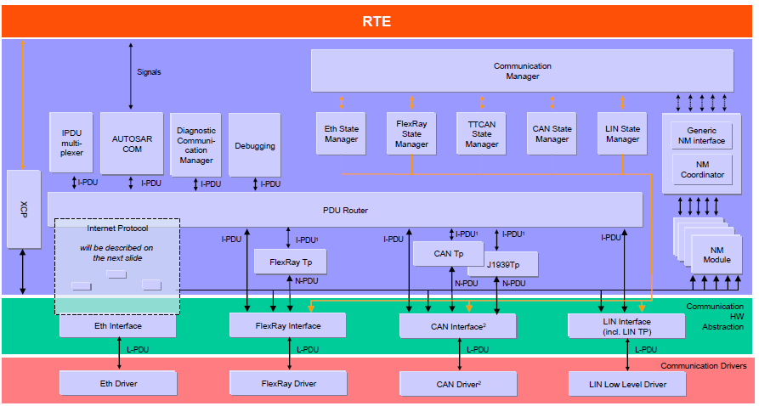
COM Stack Architecture (Autosar 4.0)
Notes:
Niranjan S K

Slide 7
Autosar COM Stack in Bosch
Main Intranet Page (shortly to be relocated to CDG intranet pages):
http://www.intranet.bosch.com/dgs/me_d-edc-17/platform/cubas/11_ComStack/index.html
Roadmap:
http://www.intranet.bosch.com/dgs/me_d-edc-17/platform/cubas/11_comstack/02_roadmap/CUBAS_COM_Roadmap.ppt
The Team:
http://www.intranet.bosch.com/dgs/me_d-edc-17/platform/cubas/11_comstack/08_team_info/index.html
RBEI and Autosar:
http://www.boschindia.com/content/language1/html/14478.htm
Autosar (internet access):
http://www.autosar.org/
Article on Bosch CUBAS (only in German):
http://www.elektroniknet.de/automotive/technik-know-how/test-entwicklungstools/article/543/0/AUTOSAR-Basis-Software_CUBAS/
Notes:
Niranjan S K

Slide 8
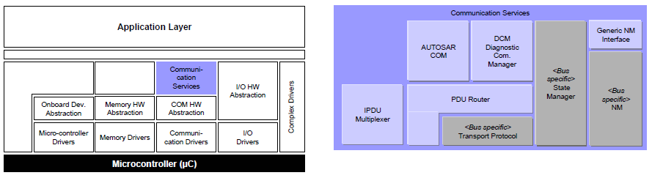
COM Stack – Communication Services
Communication Services provides Application Layer an access to vehicle network communication (CAN, LIN and FlexRay).
They basically fulfill the application need to communicate by interfacing the Application with Communication Drivers via the Communication Hardware abstraction modules.
Notes:
Niranjan S K

Slide 9
COM Stack – Communication Services
Tasks:
Provide a uniform interface to the vehicle network for communication.
Provide uniform services for network management
Provide uniform interface to the vehicle network for diagnostic communication
Hide protocol and message properties from the application.
Properties:
Implementation: μC and ECU HW independent, partly dependent on bus type
Upper Interface: μC, ECU hardware and bus type independent
Notes:
Niranjan S K

Slide 10
Communication Stack – CAN
Implementation: μC and ECU HW independent, partly dependent on CAN.
AUTOSAR COM, Generic NM Interface and Diagnostic Communication Manager are the same for all vehicle network systems and exist as one instance per ECU.
Generic NM Interface contains only a dispatcher. No further functionality is included. In case of gateway ECUs it is replaced by the NM GW which in addition provides the functionality to synchronize multiple different networks (of the same or different types) to synchronously wake them up or shut them down.
CAN Generic NM is specific for CAN networks and will be instantiated per CAN vehicle network system. CAN Generic NM interface with CAN via underlying network adapter (CAN NM).
Notes:
Niranjan S K

Slide 11
Communication Stack – CAN
The communication system specific Can State Manager handles the communication system dependent Start-up and Shutdown features. Furthermore it controls the different options of COM to send PDUs and to monitor signal timeouts.
A signal gateway is part of AUTOSAR COM to route signals.
PDU based Gateway is part of PDU router.
IPDU multiplexing provides the possibility to add information to enable the multiplexing of I-PDUs (different contents but same IDs).
Upper Interface: μC, ECU hardware and network type independent (goal)
Notes:
Niranjan S K

Slide 12
Communication Stack – LIN
The LIN Communication Services contain:
A LIN 2.0 compliant communication stack with Schedule table manager for transmitting LIN frames and to handle requests to switch to other schedule tables.
Transport protocol, used for diagnostics
A Wake-Up and Sleep Interface
An underlying LIN Driver: implementing the LIN protocol and adaptation the specific hardware
Supporting both simple UART and complex frame based LIN hardware
Notes:
Niranjan S K

Slide 13
Communication Stack – LIN
The scheduler manager and its interfaces are used to decide the point of time to send a LIN frame.
Lin Interface controls the Wake-Up/Sleep API and allows the slaves to keep the bus awake (decentralized approach).
The PDU router accesses the LIN Interface on PDU-Level, not on signal level.
The communication system specific LIN State Manager handles the communication dependent Start-up and Shutdown features. Furthermore it controls the communication mode requests from the Communication Manager. The LIN state manager also controls the I-PDU groups by interfacing COM.
When sending a LIN frame, the LIN Interface requests the data for the frame (I-PDU) from the PDU Router at the point in time when it requires the data (i.e. after sending the LIN frame header).
Notes:
Niranjan S K

Slide 14
Communication Stack – FlexRay
Implementation: μC and ECU HW independent, partly dependent on FlexRay.
AUTOSAR COM, Generic NM Interface and Diagnostic Communication Manager are the same for all vehicle network systems and exist as one instance per ECU.
Generic NM Interface contains only a dispatcher. No further functionality is included. In case of gateway ECUs, it is replaced by the NM GW which in addition provides the functionality to synchronize multiple different networks (of the same or different types) to synchronously wake them up or shut them down.
Notes:
Niranjan S K

Slide 15
Communication Stack – FlexRay
FlexRay-NM is specific for FlexRay networks and will be instantiated per FlexRay vehicle network system.
The communication system specific FlexRay State Manager handles the communication system dependent Start-up and Shutdown features. Furthermore it controls the different options of COM to send PDUs and to monitor signal timeouts.
A signal Gateway is part of AUTOSAR COM to route signals.
PDU based Gateway is part of PDU Router.
IPDU multiplexing provides the possibility to add information to enable the multiplexing of I-PDUs (different contents but same IDs).
Notes:
Niranjan S K

Slide 16
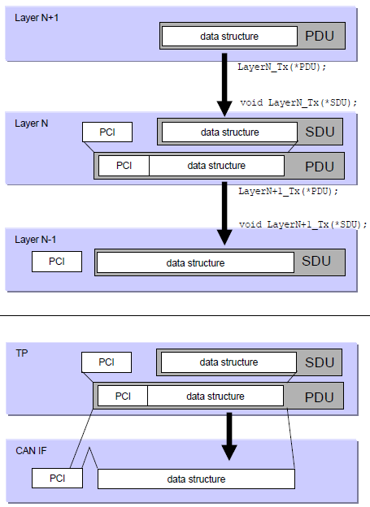
PDU Nomenclature in Autosar
SDU
SDU is the abbreviation of “Service Data Unit”. It is the data passed by an upper layer, with the request to transmit the data. It is as well the data which is extracted after reception by the lower layer and passed to the upper layer.
A SDU is part of a PDU
.
Notes:
Niranjan S K

Slide 17
PDU Nomenclature in Autosar
PCI
PCI is the abbreviation of “Protocol Control Information”. This Information is needed to pass a SDU from one instance of a specific protocol layer to another instance. E.g. it contains source and target information.
The PCI is added by a protocol layer on the transmission side and is removed again on the receiving side.
Notes:
Niranjan S K

Slide 18
PDU Nomenclature in Autosar
PDU
PDU is the abbreviation of “Protocol Data Unit”. The PDU contains SDU and PCI.
On the transmission side the PDU is passed from the upper layer to the lower layer, which interprets this PDU as its SDU.
Notes:
Niranjan S K

Slide 19
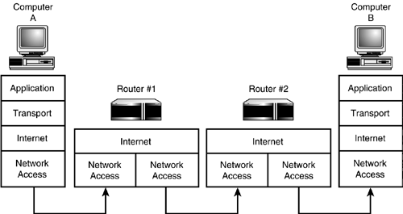
What is this ?
Notes:
Niranjan S K

Slide 20
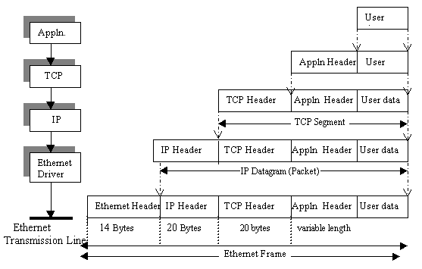
Data in TCP/IP stack
Notes:
Niranjan S K

Slide 21
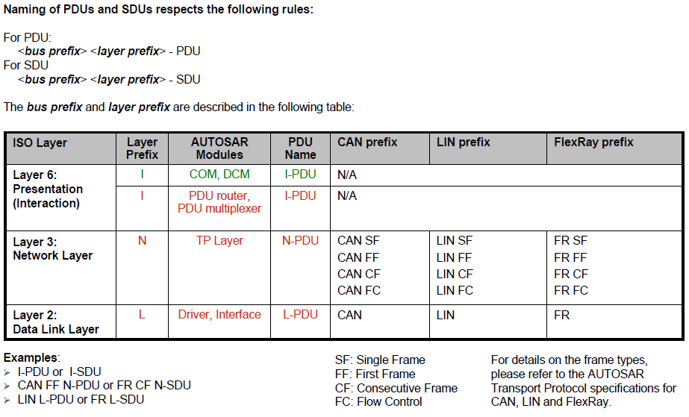
PDU Nomenclature in Autosar
Notes:
Niranjan S K

Slide 22
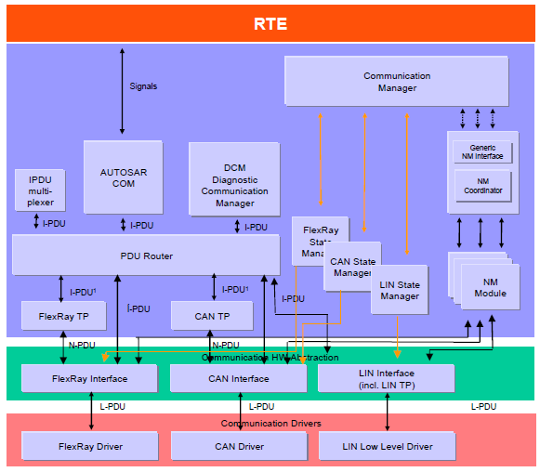
PDUs in Autosar
Notes:
Niranjan S K

Slide 23
CUBAS : COM Stack Overview
DCM
Notes:
Niranjan S K

Slide 24


Why is Diagnostics Required ?
Notes:
Niranjan S K

Slide 25
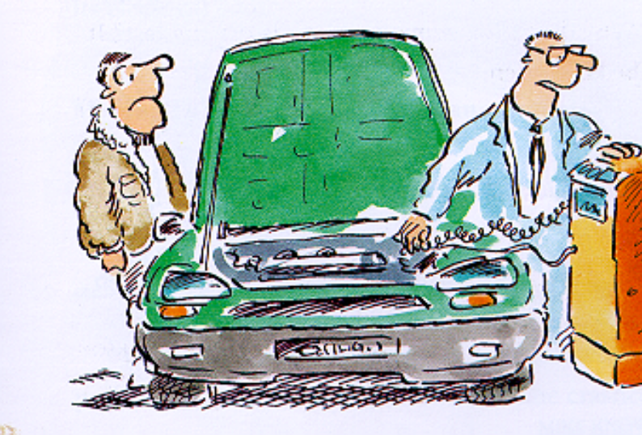
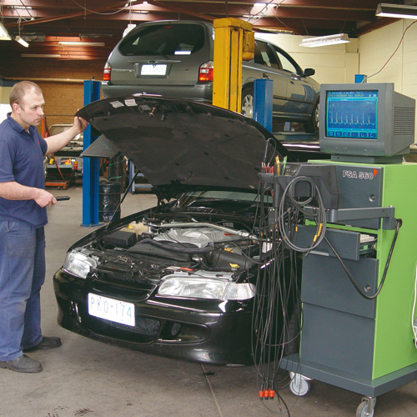
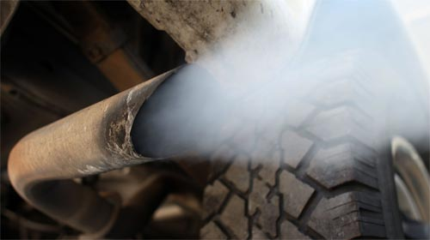
Diagnosis for Fault Detection & Avoidance
Non-legislative Diagnostics (Enhanced diagnostics, OEM diagnostics)
Legislative Diagnostics (Emission)
e.g.
1) OBD
2) CARB
e.g.
1) UDS
2) KWP
Notes:
Niranjan S K

Slide 26
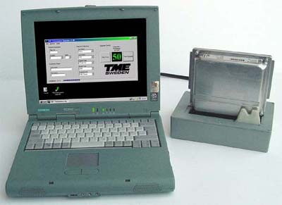
Flashing (Development, EOL, Service Centre)
Notes:
Niranjan S K

Slide 27



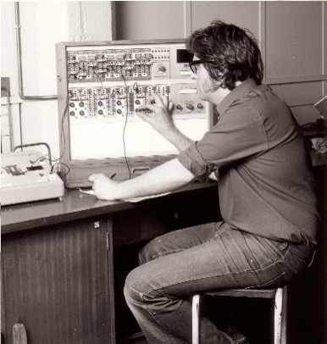
Calibration
After Calibration
Before Calibration
Process of Calibration & Data Acquisition
Notes:
Niranjan S K

Slide 28
Why is Diagnostics required ?
Diagnostics in Automobiles are basically required for the following reasons:
Retrieve diagnostic information from the ECU to the external tester equipment.
Download software and data into flash memory devices
Calibration and Data Acquisition
Notes:
Niranjan S K

Slide 29
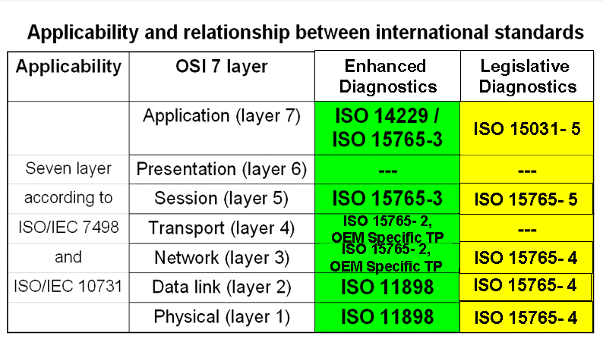
ISO specifies Standard for Diagnostics
Notes:
Niranjan S K

Slide 30
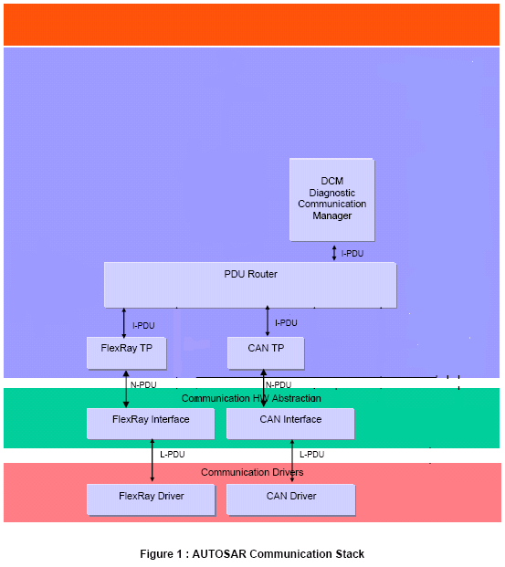
Diagnostics in Autosar Communication Stack
Notes:
Niranjan S K

Slide 31
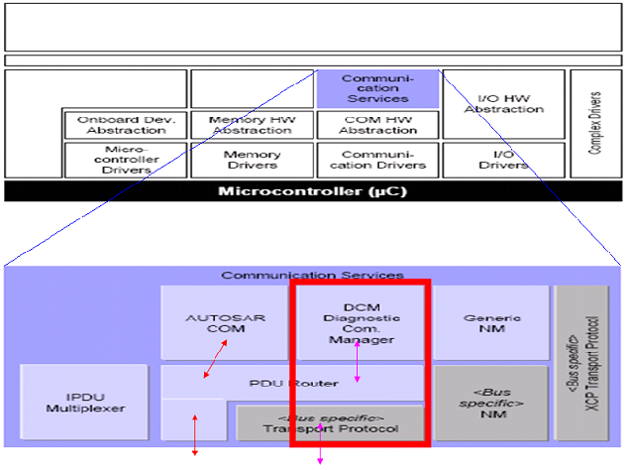
DCM in Autosar Architecture
Notes:
Niranjan S K

Slide 32
Details of Diagnostic Communication Stack
  Diagnostic communication allows a tester to control diagnostic functions in an on-vehicle Electronic Control Unit.
  • DCM stands for Diagnostic Communication Manager.
  • Diagnostic communication is Client - Server communication.
  Client is tester and Server is ECU. Client initiates the
  communication.
  • Data transfer size can be more than single N-PDU size. Hence
  DCM stack needs a separate module called Transport protocol
  (TP) which does the assembling of data (request) while receiving
  and segmenting the data (response) while sending from the
  Server.
  • Transport protocol is medium dependent. i.e. CAN medium has
  CAN-TP, FlexRay medium has FrTp etc. Pdu Router (PduR) provides
  the medium encapsulation to DCM module.
Notes:
Niranjan S K

Slide 33
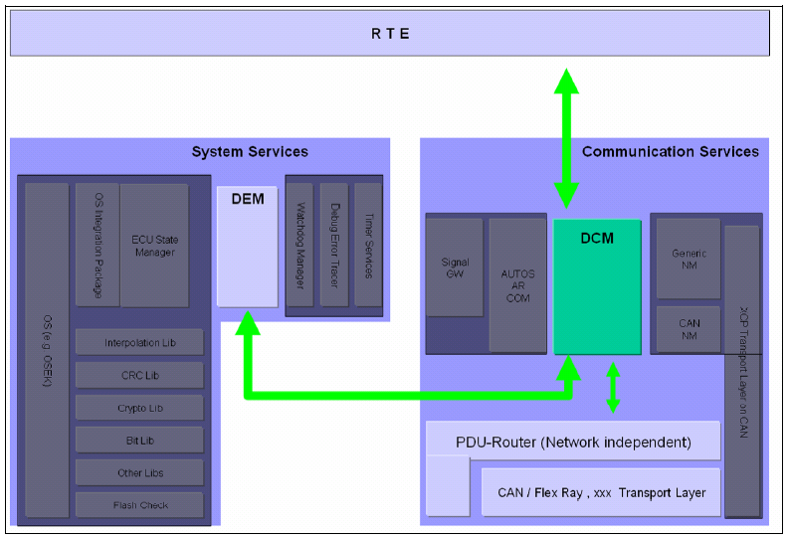
Interfaces to DCM in Autosar Architecture
Notes:
Niranjan S K

Slide 34
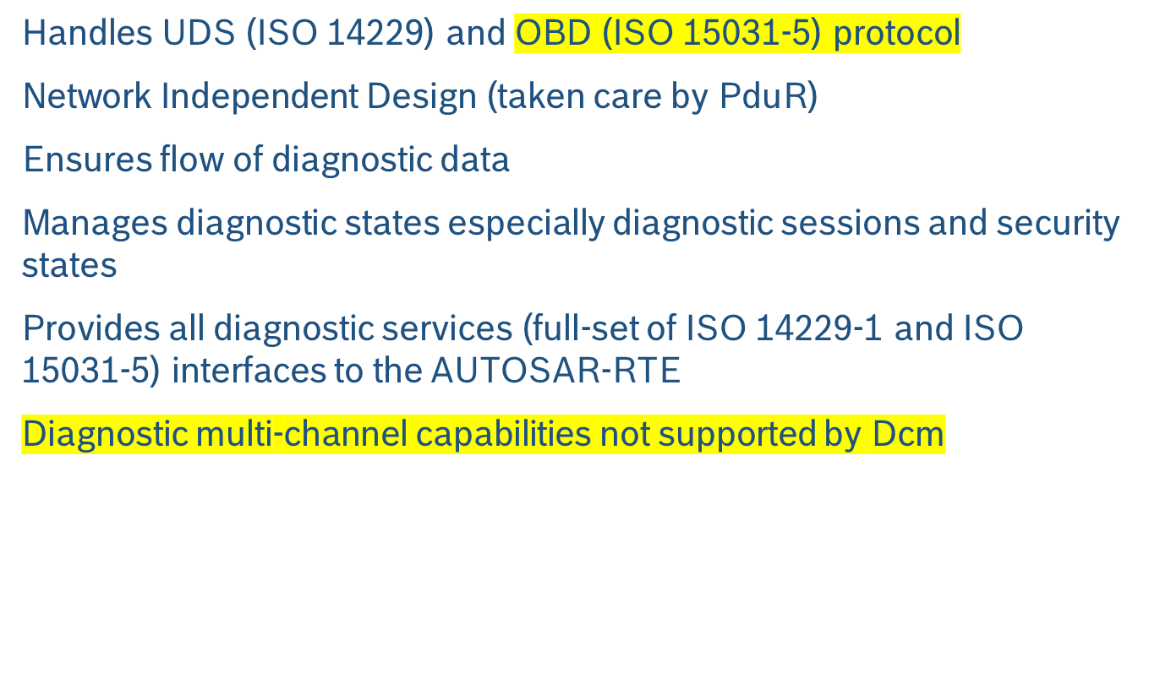
Features of DCM
Notes:
Niranjan S K

Slide 35
Functional Blocks of DCM
DSP – Diagnostic Service Processing - is mainly a container for completely implemented diagnostic services that are common amongst the different applications (e.g. access to the fault data) and thus do not need to be implemented by the application.
DSD – Diagnostic Service Dispatcher – does the work of receiving new diagnostic requests over a network and forwarding the same to data processor. Moreover it also does the transmission a diagnostic response over a network when triggered by the data processor.
DSL – Diagnostic Session Layer - ensures data flow concerning diagnostic requests and responses. DSL also supervises and guarantees diagnostic protocol timing. Furthermore DSL manages diagnostic states (esp. diagnostic session and security).
Notes:
Niranjan S K

Slide 36
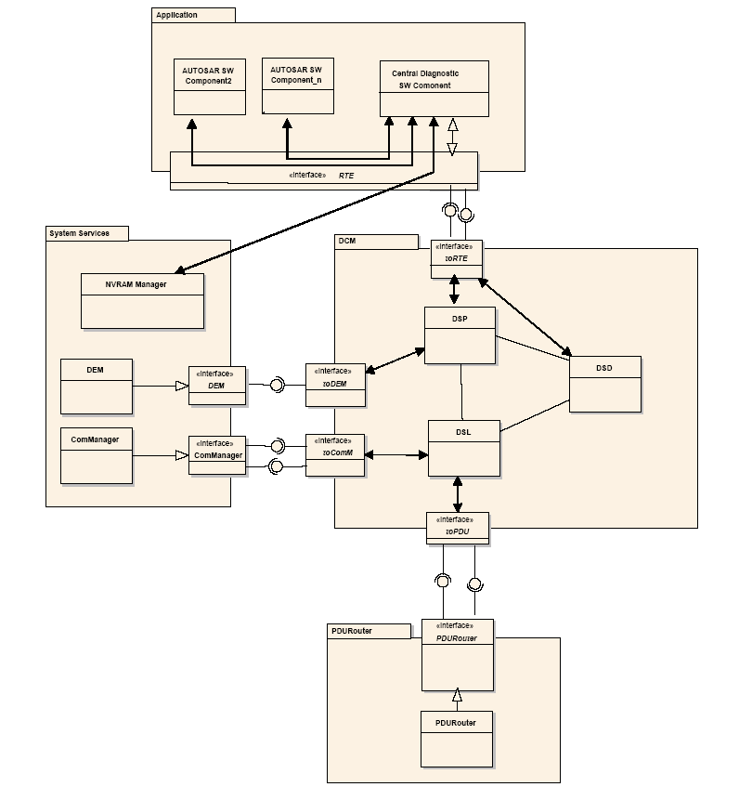
DSP, DSL and DSD
Notes:
Niranjan S K

Slide 37
DSL – Diagnostic Session Layer
Functional areas of DSL are in conformance with the specifications ISO14229-1 (Unified diagnostic services (UDS)) and the network independent part of ISO15765-3 (UDS on CAN).
No network dependent functional area in the DSL
Layer to support “concurrent” tester present (keep alive logic)
Support Periodic Transmission
Support Response on Event
Support Paged Buffer handling for efficient buffer management
Notes:
Niranjan S K

Slide 38
DSL – Diagnostic Session Layer
Support of Response Pending in case the application is not able to respond within P2MAX, to extend the timings for application.
Managing Security Level
Managing Session State and Session changes
Control change of timing parameters (P2ServerMin, P2ServerMax, P2*ServerMin, P2*ServerMax, S3Server)
Pre-emption between Protocols
Notes:
Niranjan S K

Slide 39
DSD - Diagnostic Service Dispatcher
Positive Response, Negative Response
Suppression of Positive Responses
Suppression of certain negative responses for Functional addressing
Notes:
Niranjan S K

Slide 40
DSP - Diagnostic Service Processing
The DSP implements a set of diagnostic services required to provide basic diagnostic functionality. This implementation covers following diagnostic functionality:
diagnostic session transitions
locking and unlocking of specific diagnostic service per Security Access
reading of ECU resident DTCs and associated data
deletion of ECU resident DTCs and associated data
enabling and disabling of DTC storage
reading and writing of diagnostic data
Control of diagnostic routine
Notes:
Niranjan S K

Slide 41
Emissions-related diagnostic services
legislated emission related diagnostic service for reading Current Diagnostic Data data (service 0x01) (Emissions-related applications only)
legislated emission related diagnostic service for reading freeze-frame data (service 0x02) (Emissions-related applications only)
legislated emission related diagnostic services for accessing the fault data (service 0x03 and 0x07) (Emissions-related applications only)
legislated emission related diagnostic service for clearing fault data (service 0x04) (Emissions-related applications only)
Notes:
Niranjan S K

Slide 42
Unified Diagnostic Services
Diagnostic event manager interface: Clear Diagnostic Information (service 0x14), Read DTC Information (service 0x19), Control DTC Setting (service 0x85).
Diagnostic communication and security: Diagnostic Session Control (service 0x10), Tester Present (service 0x3E), Security Access (service 0x27)
Diagnostic data access: ReadDataByIdentifier (service 0x22), ReadDataByPeriodicIdentifier (service 0x2A), WriteDataByIdentifier (service 0x2E), InputOutputControlByIdentifier (service 0x2F), RoutineControl (service 0x31), ReadScalingDataByIdentifier (service 0x24), DynamicallyDefineDataIdentifier (service 0x2C)
Reset control: EcuReset (service 0x11)
Notes:
Niranjan S K

Slide 43
Basic Request and Response Handling in DCM
After receiving the request, search for the requested service in service table
If service not found send negative response
Check requested service is allowed in running session, if not send negative response
Check requested service is allowed in running security level, if not send negative response
Invoke the service
Call the service till service finishes the processing
Framing the Positive/negative responses
Monitoring the timings (P2max,P2* max, S3 max etc). If Service unable to give response with in P2 max or P2 * max then send negative response with NRC 0x78 to get enhanced timing
Buffer handling
Suppressing of responses
Notes:
Niranjan S K

Slide 44
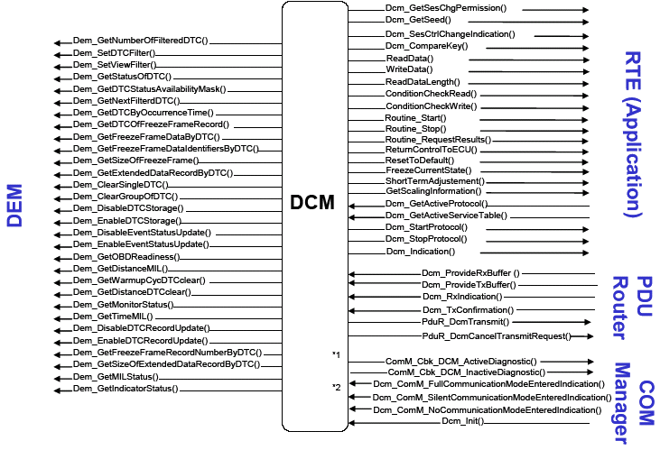
API Exchange between DCM and other modules
Notes:
Niranjan S K

Slide 45
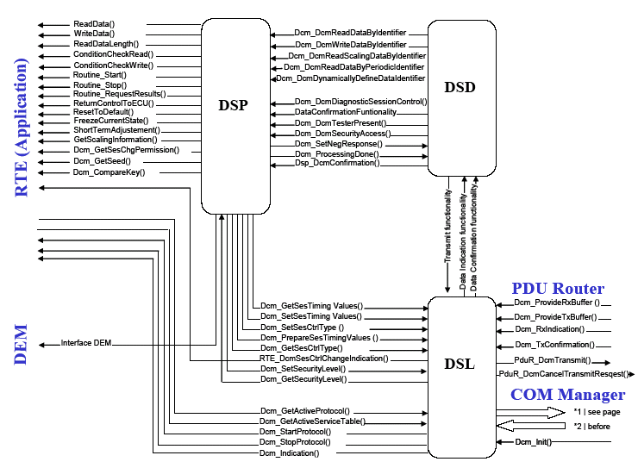
Detailed usage of APIs within DCM
Notes:
Niranjan S K

Slide 46
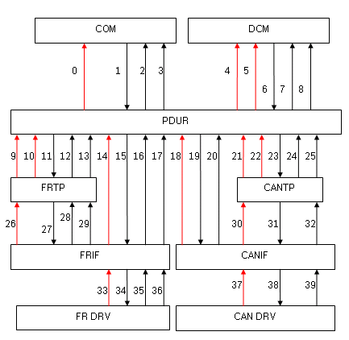
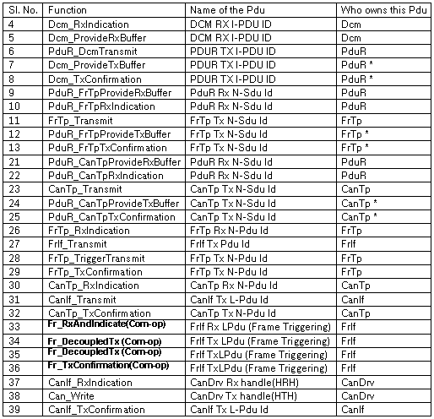
Flow of Control in Rx and Tx Path of DCM Stack
Notes:
Niranjan S K

Slide 47
CUBAS : COM Stack Overview
COM
Notes:
Niranjan S K

Slide 48
CUBAS-COM: Why Com?
Usecase: Three signals (Engine speed, Engine temp and Coolant temp) to be transmitted from ECU-A to ECU-B.
  Option1: One signal per frame/IPDU
    Disadvantage: Increase in bus load.
ECU-A
CAN BUS
Engine speed
IPDU 1
Engine Temp
IPDU 2
Coolant Temp
IPDU 3
CAN BUS
ECU-B
Notes:
Niranjan S K

Slide 49
CUBAS-COM: Why Com?
  Option2: All three signals(Engine speed, Engine temp and Coolant temp) packed into a Frame/IPDU
ECU-A
CAN BUS
S1
S2
S3
IPDU 1
CAN BUS
ECU-B
S1
Engine speed
S2
Engine Temp
S3
Coolant Temp
Notes:
Niranjan S K

Slide 50
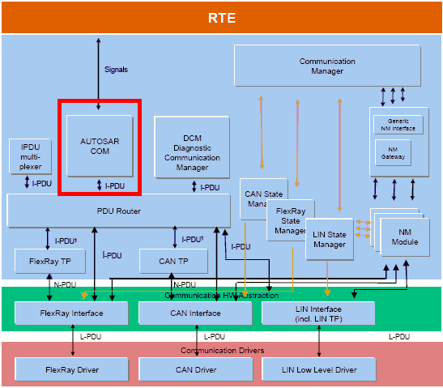
CUBAS-COM:Introduction
Within the AUTOSAR Layered Architecture the COM module is placed between RTE and PDU Router.
Notes:
Niranjan S K

Slide 51
CUBAS-COM:Main Features
Packing of Autosar Signals to I-PDUs to be transmitted.
S1
S2
S3
S4
RTE
I-PDU
S1
S2
S3
S4
S1
S2
S3
S4
COM
Notes:
Niranjan S K

Slide 52
CUBAS-COM:Main Features
Unpacking of received I-PDUs and provision of received signals to RTE
S1
S2
S3
S4
RTE
I-PDU
S1
S2
S3
S4
S1
S2
S3
S4
COM
Notes:
Niranjan S K

Slide 53
CUBAS-COM:Main Features
Routing of signals from received IPDUs into IPDUs to become transmitted.
Signal Gateway
COM
S1
S2
S3
S1
S2
S1
S2
S3
S1
S2
I-PDU
I-PDU
Notes:
Niranjan S K

Slide 54
CUBAS-COM:Main Features
Monitoring of received signals(Signal Timeout).
S1
S2
S3
S4
Error
Notification
S1
S2
S3
S4
COM
Rx Deadline
monitoring
Com_RxIndication()
S1
S2
S3
S4
PDUR
PDU
Notes:
Niranjan S K

Slide 55
CUBAS-COM:Main Features
Communication transmission control(Start/Stop of I-Pdu groups).
Filter mechanisms for incoming signals
Endianess conversion.
Signal based gateway.
Notes:
Niranjan S K

Slide 56
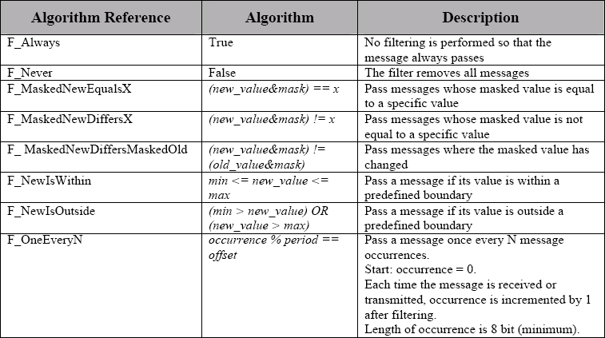
CUBAS-COM:General Functionality
Filtering.
  Filtering out signals only takes place at receiver side.
  Autosar COM shall only provide the following filter types.
Notes:
Niranjan S K

Slide 57
CUBAS-COM:General Functionality
Endianess Conversion.
  Endianess conversion (BIG-ENDIAN to LITTLE-ENDIAN and vice versa)
  Endianess conversion takes place on the sender side before messages are stored in the I-PDU.
  Endianess conversion takes place on the receiver side when messages are retrieved from the I-PDU.
Notes:
Niranjan S K

Slide 58
CUBAS-COM:General Functionality
  new_value
    Current value of the message
  old_value
    Last value of the message (Initialized with the initial value of the message, updated with the new_value if the value is not filtered out)
  mask, x, min, max, period, offset
    Constant values
  Occurance
    A count of the number of occurences of this message.
Notes:
Niranjan S K

Slide 59
CUBAS-COM:Communication modes
  Communication Modes
    Defines signal flow in Autosar COM and how the different transmission modes in Autosar COM is defined.
  Signal Transfer Property
Transfer Property
Triggered
Pending
Causes immediate transmission
of the I-PDU
Does not cause immediate transmission
of an I-PDU
Condition: only if Transmission Mode
is Direct/N-times or Mixed
Notes:
Niranjan S K

Slide 60
CUBAS-COM:Communication modes
  Transmission Mode
Direct / N-Times: Transmission of an I-PDU with this TM is caused by
the transfer of any signal assigned to the I-PDU with the
“Triggered” TP
The transfer of the signal to AUTOSAR COM is immediately
followed by n transmissions on the underlying layer
Periodic : COM issues periodic transmission requests for an I-PDU to
    the underlying layer
Mixed : Combination of “Direct” & “Periodic”
None : No transmission is initiated by AUTOSAR COM
It shall only be possible to request I-PDU’s with
Com_TriggerTransmit( )
Notes:
Niranjan S K

Slide 61
CUBAS-COM:Communication modes
  Transmission Mode Configuration
    Transmission Mode TRUE
    Transmission Mode FALSE
Notes:
Niranjan S K

Slide 62
CUBAS-COM:Communication modes
  Signal Flow and Transmission Mode Selection
I-PDU
True
Evaluation
of TMC
Signal 1
False
Signal 1
Update Signal in I-PDU
True
Evaluation
of TMC
Signal 2
False
Signal 2
Update Signal in I-PDU
True
Evaluation
of TMC
Signal 3
False
Signal 3
Update Signal in I-PDU
Evaluation
of TMS for I-PDU
Notes:
Niranjan S K

Slide 63
CUBAS-COM:Handling of IPDUs
  Signal
    A piece of information that needs to be received or transmitted. The message could be in the form of bit, uint8/16/32, sint8/16/32. Examples of message are engine speed, oil temperature etc.
  Signal Group
    In Autosar, so called complex data types are used. Inside a complex data type, there are one or more data elements (Group signals). i.e Grouping of one or more Group signals is called Signal Groups.
    Group Signal
      Similar to Signals, but these signals will be present within Signal Groups.
  IPDU
    Interaction layer Protocol Data Unit.
    An I-PDU carries signals.
  IPDU Group
    An IPDU Group Contains zero or more I-PDUs.
  IPDU Group Group
    An IPDU Group Group Contains zero or more I-PDU Groups.
Notes:
Niranjan S K

Slide 64
CUBAS-COM:Handling of IPDUs
  Pictorial representation of Signals, Signal Group, Group Signal, Ipdu, Ipdu Group
S1
S2
S3
S4
S1
S2
S3
S4
S1
S2
S3
S4
Signals
Signal Group
Group Signal
I-PDU
I-PDU Group
Notes:
Niranjan S K

Slide 65
CUBAS-COM:Handling of IPDUs
  Signal Indication
    In order to support both Interrupt driven and polled system, it shall be configurable when the signal indication takes place.
      Immediate
      Deferred / Polling
    Immediate
      In Immediate mode, signal indication will be done in Com_RxIndication().
    Deferred / Polling
      In Deferred mode: First in Com_RxIndication() the IPDUs data shall be copied from the underlaying layer into COM. Then the signal notification shall be processed asynchronously, for example during next call to Com_MainFunctionRx().
Notes:
Niranjan S K

Slide 66
CUBAS-COM:Handling of IPDUs
  IpduGroup Start
    CUBAS-COM shall provide a routine which starts communication per I-PDU Group. The name of the routine is Com_IpduGroupStart().
    Starting an IPDU Group shall permit to transmit/receive IPDUs which belong to the IPDU group.
  IpduGroup Stop
    CUBAS-COM shall provide a routine which stops communication per I-PDU Group. The name of the routine is Com_IpduGroupStop().
    Stopping an IPDU Group shall not permit to transmit/receive IPDUs which belong to the IPDU group.
Notes:
Niranjan S K

Slide 67
CUBAS : COM Stack Overview
Network Management
Notes:
Niranjan S K

Slide 68
Network Management : Introduction
  NM is a software used to monitor and shutdown the ECU networks synchronously
  The NM stack consists of two layers – Generic NM Interface and Bus specific NM
  Generic NM Interface translates the application requests to the corresponding Bus specific NM modules
  Bus specific NM modules implement the algorithms to shut down ECU networks synchronously
Notes:
Niranjan S K

Slide 69
Network Management : Architecture
Architecture Diagram
Application controlling NM
NM Interface Layer
FlexRay NM
CAN NM
BUS Interface (FlexRay or CAN)
Notes:
Niranjan S K

Slide 70
Network Management : NM Interface
  The Generic Network Management Interface is an adaptation layer between the AUTOSAR Communication Manager and the AUTOSAR Bus specific network management modules (e.g. CAN Network Management or FlexRay Network Management)
  Additionally, it can also be used to handle network interoperability i.e., multiple networks can be shut down synchronously
Notes:
Niranjan S K

Slide 71
Network Management : FlexRay NM
  The AUTOSAR FlexRay Network Management is a hardware dependent protocol that can only be used on FlexRay. Its main purpose is to coordinate the transition between normal operation and bus-sleep mode of the network.
  In addition to the core functionality optional features are provided e.g. to implement a service to detect all present nodes or to detect if all other nodes are ready to sleep.
Notes:
Niranjan S K

Slide 72
Network Management : FlexRay NM
  The basic philosophy of NM is to send messages as long as network is required by the ECU. When a particular node doesn’t require network, it stops transmission
  If bus communication is released and there are no NM-messages on the bus for a configurable amount of time determined by FrNmReadySleepCnt (configuration parameter), the FlexRay NM module shall perform the transition into the Bus-Sleep Mode.
Notes:
Niranjan S K

Slide 73
Network Management : FlexRay NM
FrNm comes out of Bus Sleep mode whenever it receives an NM message or application invokes FrNm_NetworkRequest
NM messages that keep the bus awake are called NM Votes
An NM Vote can be either positive or negative depending on whether the application has requested bus communication or not
Notes:
Niranjan S K

Slide 74
Network Management : FlexRay NM
FrNm stays in Normal Operation state as long as application requests Bus communication
It sends positive NM Votes in Normal Operation state
When application calls FrNm_NetworkRelease, FrNm moves to Ready Sleep and starts the counter ReadySleepCnt. It starts sending “negative” NM votes
When all NM nodes stop sending positive Votes, and when Ready Sleep counter expires, FrNm does a transition to Bus Sleep state
Notes:
Niranjan S K

Slide 75
Network Management : CAN NM
  The AUTOSAR CAN Network Management is a hardware independent protocol that can only be used on CAN. Its main purpose is to coordinate the transition between normal operation and bus-sleep mode of the network.
  In addition to the core functionality optional features are provided e.g. to implement a service to detect all present nodes or to detect if all other nodes are ready to sleep.
  The CAN Network Management (CanNm) function provides an adaptation between Network Management Interface (Nm) and CAN Interface (CanIf) module.
Notes:
Niranjan S K

Slide 76
Network Management : CAN NM
  Like FlexRay NM, CAN NM also has three modes – Bus Sleep, Network and Prepare Bus Sleep
  Difference is that there is no Synchronize mode in CAN NM. But there is extra mode called Prepare Bus Sleep mode.
  The purposes of Bus Sleep and Network modes are similar to FrNm.
  Prepare Bus Sleep is a temporary state where all nodes wait for any unexpected message and move into Bus Sleep if no message is received
Notes:
Niranjan S K

Slide 77
Network Management : CAN NM
  In CAN NM, messages are sent as long as application requires bus communication. When application no more need bus, NM is indicated to stop transmission (unlike FrNm where negative Votes are sent)
  Whenever any message is received or transmitted, an internal timer NM-Timeout is restarted. This is a network-wide parameter and should be same for all nodes.
  As soon as NM-Timeout expires in Network mode, CanNm does a transition to Prepare Bus Sleep, where it waits for a duration of WaitBusSleepTime. Once this timer expires, all nodes go to Bus Sleep
Notes:
Niranjan S K

Slide 78
Thank You !
Notes:
Niranjan S K

